Slide 1
BioSensing Ver 1.0
Team Member(s): Vishal Chhatwani
Zhiyuan Shi
Xin Zhao
Product Owner(s): Dr. Shekhar Bhansali
Instructor: Masoud Sadjadi
School of Computing and Information Sciences Florida International University
Final Presentation
<Fall 2016>
The logo of your project
Notes:
7 seconds.
Greet your audience, thank them for attending your presentation, introduce yourself, introduce your project, introduce your team members, and quickly indicate what each of you did in a high-level manner, and put more emphasis on your part/contribution.

Slide 2
Project definition
Problem
Biosensing App is a system which combines biosensor device, mobile application and cloud service together to detect, calibrate and analyze individual patient’s different kind of analyte such as blood pressure, heart rate or alcohol level for clinical purpose.
The patient’s status should be monitored continuously
Doctor wish to monitor the patient’s data remotely
Patient’s want to check his/her status automatically
Doctor want to analyze a patient’s data remotely
Notes:
10 seconds.
Introduce the problem that the whole project (in all versions) tackles with GIF or screenshot.

Slide 3
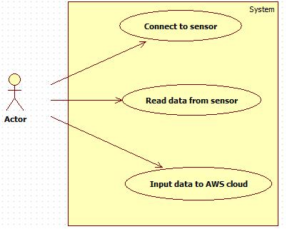
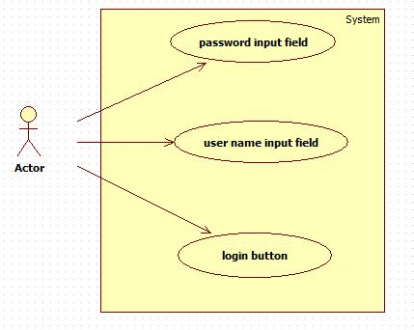
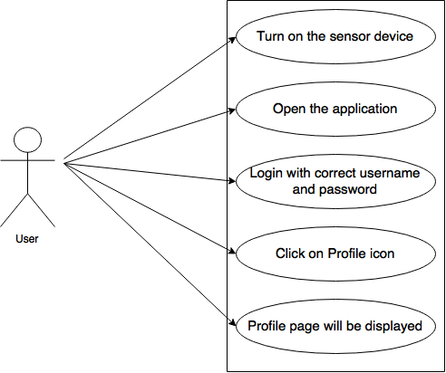
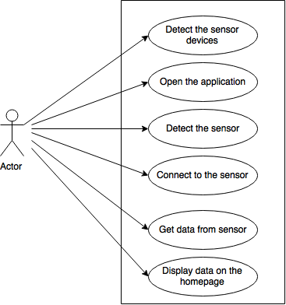
Requirements: Use Cases
Notes:
5 seconds
Show the Use Case Diagram for the whole project. Highlight your use cases.

Slide 4
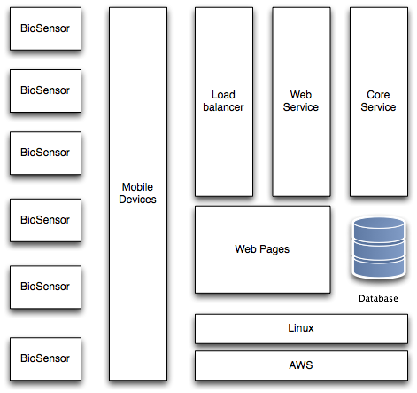
System Design: Architecture
Notes:
20 seconds
System design: Highlight the parts that you contributed to them.
1. System decomposition; identify the architecture patterns used
2. System deployment – h/w and s/w requirements

Slide 5
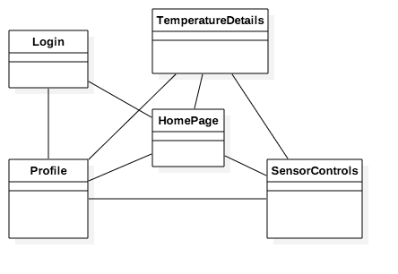
Minimal Class Diagram
Notes:
10 seconds.Minimal class diagram. Highlight the classes that you created/modified
Identify the design patterns used (one or more slides).

Slide 6
User Stories
1.As a User, I would want to see the live data that is collected from sensor to be shown on the iOS app
2.As a user, I want to connect to the sensor, so that I can get the data and signal strength(RSSI) from sensor and input data to AWS cloud database per 15 seconds.
3.As a User, I want to have a profile page so that i can see my information like name, phone no, email address etc.
4.As a user, I want to have a login page, so that I can log in the APP.
Notes:
5 seconds.
List the user stories that you worked on them.(put in order of importance). Stay focused on the parts that you have been working.

Slide 7
Implemented User Stories
User Story #132 Setting up the AWS cloud
User Story #126 Read data from sensortag device
User Story #147 Monitor patient data on the website
User Story #127 Display sensor data on the app
User Story #140 Download patient data from website
User Story #150 Design a profile page in iOS app
User Story #153 Design a Login page in iOS app
User Story #156 Make a Homepage in iOS app
User Story #158 Design an UI for iPhone 5
User Story #159 Connect and read data from new sensor (made by our team)
User Story #160 Implement Login Feature
User Story #161 Convert hexadecimal data from new sensor to decimal form
Pending User Stories
There were some other things that we planned to do but could not complete due to time limit and resources.
User Story #152 Make a Line graph in the iOS app
User Story #146 Add sensor control feature in iOS app
User Story #144 Email .csv file from iOS app

Slide 8
User Story #126 Read data appropriately from sensor SensorTag CC 2650
As a user, I want to connect to the sensor, so that I can get the data and signal strength(RSSI) from sensor and input data to AWS cloud database per 15 seconds.
Notes:
60 seconds
The tile of user story
The most important user story you worked on it. You have to describe this one very well and be proud of that.
Please present and show the complexity of your work, code, algorithms, and technical challenges and technologies you have used. (you could use screenshot if you want. Visual presentations are better than text presentation)
Go into the details of the most important/significant tasks using bullet lists or visual graphs or state chart diagram
Sequence Diagram for this user story is mandatory (in another separate page if required)
Demo using screenshots or GIF (in another separate page if required)

Slide 9
User Story #140 Download a patient's monitoring data
As a doctor, I would like to download a patient’s data so that I am able to put the data into a healthy report or use the data to do some advanced analysis
Notes:
20 seconds
The tile of user story
Please present and show the complexity of your work, code, algorithms, and technical challenges and technologies you have used. (you could use screenshot if you want. Visual presentations are better than text presentation) - Go into the details of the most important/significant tasks using bullet lists or visual graphs or state chart diagram - Demo using screenshots or GIF (in another separate page if required)
Sequence Diagram for this user story is optional

Slide 10
User Story #127 Display data on the app
As a user, I want to open the app and detect my sensor device
Then I would like to connect to my sensor device.
After that it should get the data from sensor and show me on the app.
Notes:
20 seconds
The tile of user story
Please present and show the complexity of your work, code, algorithms, and technical challenges and technologies you have used. (you could use screenshot if you want. Visual presentations are better than text presentation) - Go into the details of the most important/significant tasks using bullet lists or visual graphs or state chart diagram - Demo using screenshots or GIF (in another separate page if required)
Sequence Diagram for this user story is optional

Slide 11
User Story #172 List all the patients
As a doctor I would like to be able to list all my patients so that I can view all my patients and select to view a patient’s information in details from the list
Notes:
20 seconds
The tile of user story
Please present and show the complexity of your work, code, algorithms, and technical challenges and technologies you have used. (you could use screenshot if you want. Visual presentations are better than text presentation) - Go into the details of the most important/significant tasks using bullet lists or visual graphs or state chart diagram - Demo using screenshots or GIF (in another separate page if required)
Sequence Diagram for this user story is optional

Slide 12
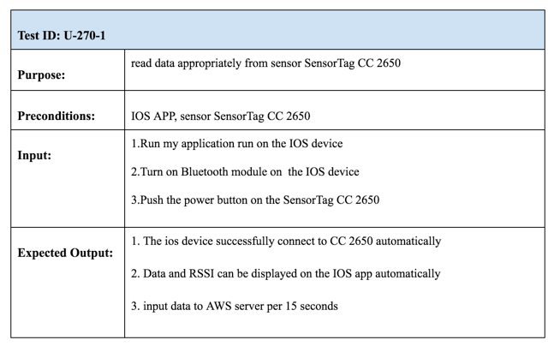
Test Suites and Test Cases

Slide 13
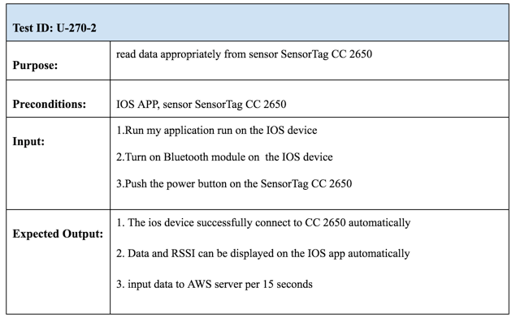

Slide 14
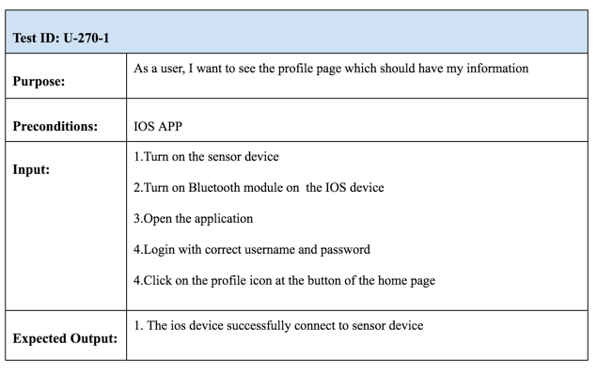

Slide 15
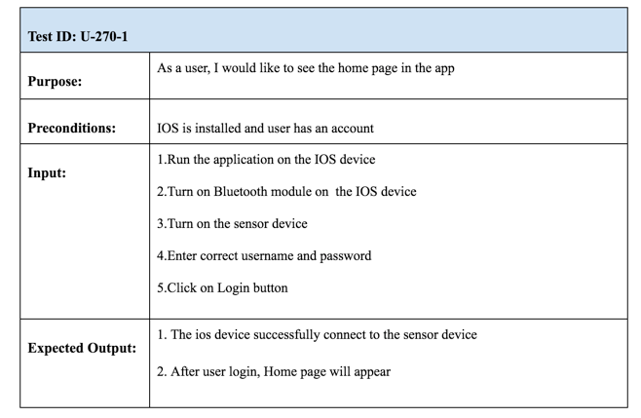

Slide 16
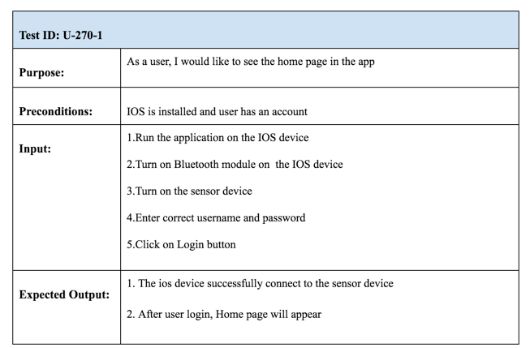

Slide 17
Summary
Summary
In this project we:
Build connection between biosensors and Mobile device
Developed a mobile application for biosensors
Developed a cloud service for Doctors to monitor the biosensors data
Questions?
Thank You!
Notes:
10 seconds
Summarize your contribution, mention your effort for Scrum, Mingle, Github, Google Drive Documentation and minutes
Include your contact information
Ask if anyone has any questions for you.
Thank your audience

